Slide 1
Daiki-Axis -Johkasou
Onsite Used water management concept and Technology from Japan and how it can contribute to Swachh Bharat
Treat Used water at site & Reuse at site
17th Feb 2024

Slide 2
Agenda
  Johkasou Introduction
  Johkasou in India
  Case Studies
  Daiki Axis support model for SBM
  Top fitment case
  Talk to me.

Slide 3
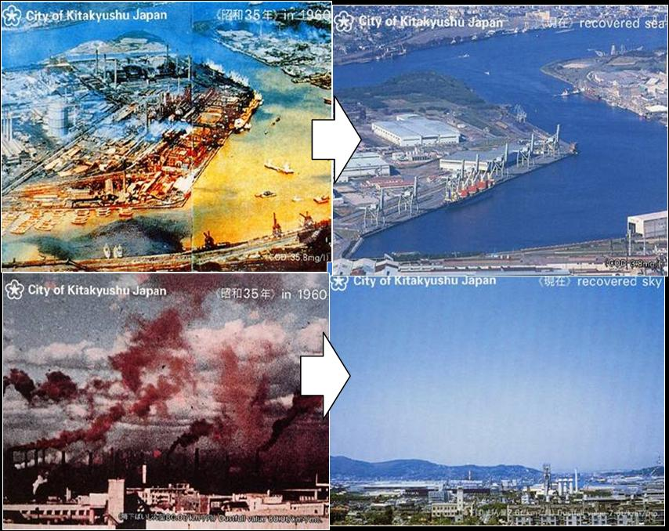
Government activities
Japan was most polluted countries in the world in 1960’ to 1970’

Slide 4
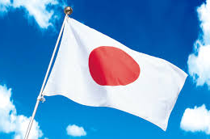
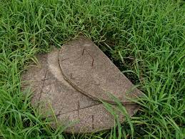
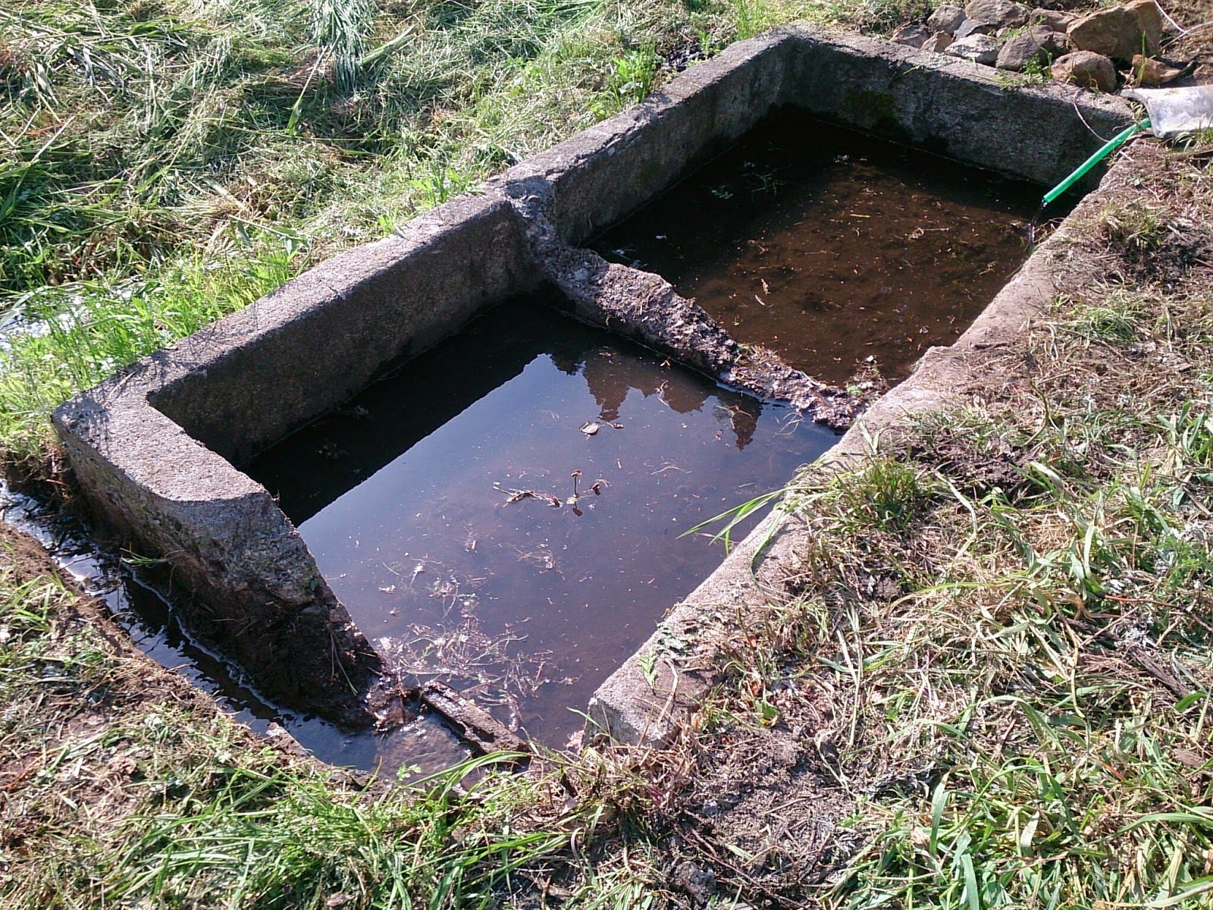
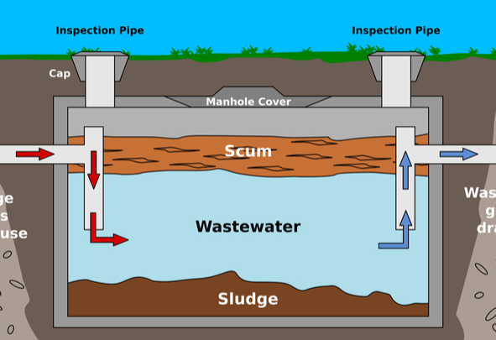
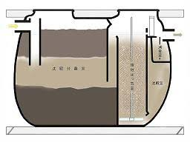
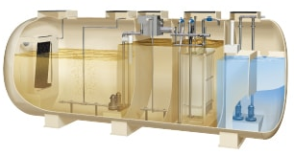
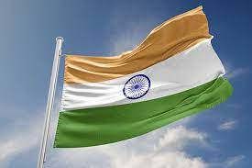
History of Onsite treatment in Japan
Japan and India Onsite treatment comparasion
Collection pit
Soak pit
Septic tank
Black Water
Johkasou
Black & Gray Water
Johkasou
～１９４５
～１９５５
～１９７０
～１９８０
ＮＯＷ
Collection pit
Soak pit
Septic tank
Black & Gray Water
Johkasou
～？？
～２０００
～２０１０
ＮＯＷ？？
Future

Slide 5

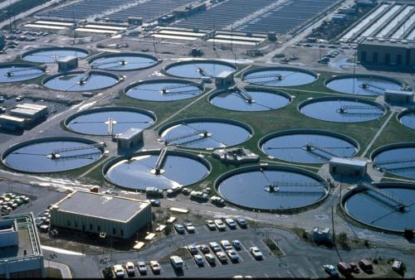
Basic concept_ Onsite Treatment
Johkasou Basic concept is `Treat at Site, Reuse at Site’.
Even High-density area, Johkasou can treat usedwater at site and improve effectiveness of centralized STPs
‘ Treat at site, reuse at site ’
Centralized STP
Ｊ
Ｊ
Ｊ
Ｊ
Install Remote area
Ｊ
Ｊ
Ｊ
Ｊ
Ｊ
Ｊ
Ｊ
Ｊ
Ｊ
Ｊ
Ｊ
Ｊ
Ｊ
Install Residencial area
Install High-Density area
Piping installation & maintenance
Remote Area
No need Piping & collect wastewater to Centralized STP
Complementary to
Centralized STP
High-density Area
Reduce pressure to Centralized STP

Slide 6
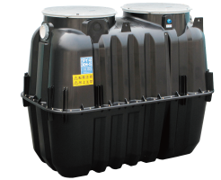
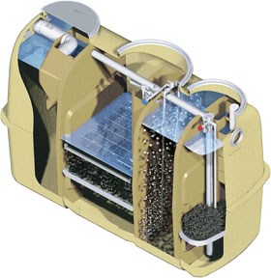
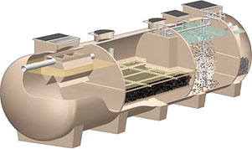
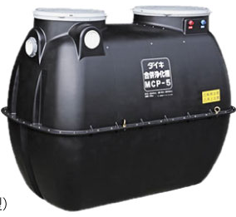
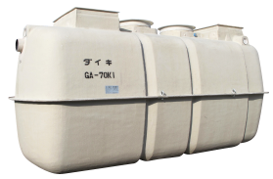
JOHKASOU-STP from Japan –MADE IN INDIA for INDIA
Capsule Type: 1～25KLD
Cylinder Type:20～75KLD
Inlet
Primary
Secondary
Tertiary
Domestic
Black & Gray
Screen chamber etc
Johkasou-STP
Sand & Active carbon filter etc
BOD 300
TSS 250
BOD 300
TSS 200
Gardening
Water
Toilet
Flush
CPCB
NGT

Slide 7
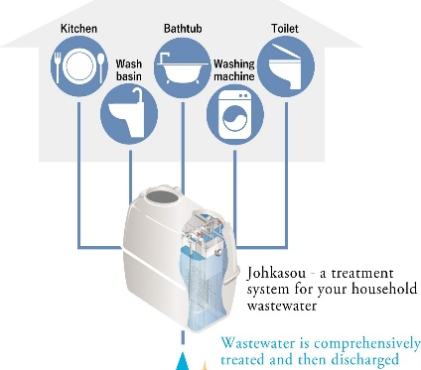


Explanation of Internal Treatment Process
B
Aeration Blower
Re-Circulation
Disinfection
Separation
Anaerobic Contact Media Chamber
Aeration Chamber
(MBBR)
1st
Sedimentation
2nd
Sedimentation
Daiki Axis Johkasou process highlights:
Gravity flow
Internal capacity to mange peak and low flow
Avoids need for Full time operators and daily sludge handling at site

Slide 8
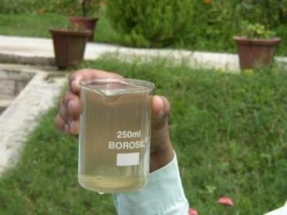
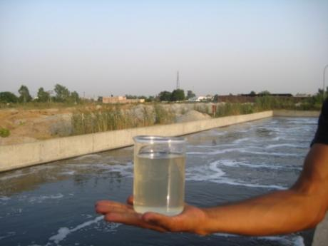
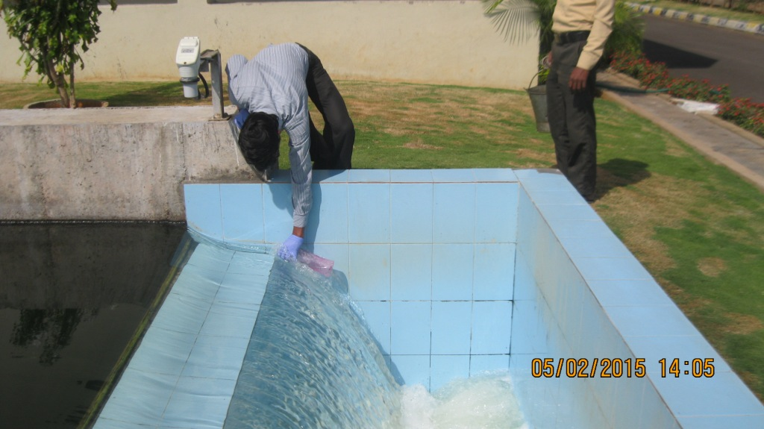
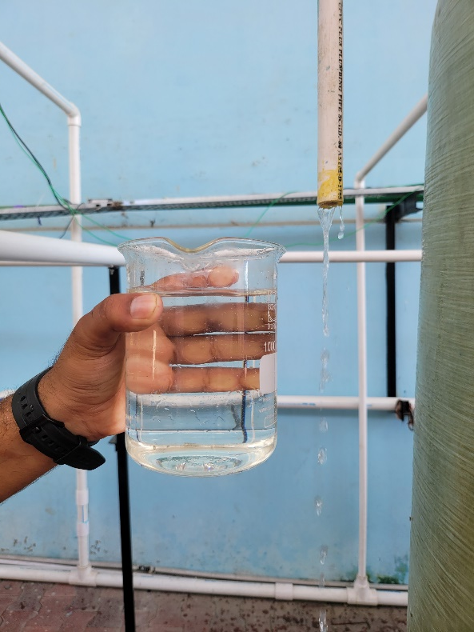
IIT R study of Johkasou and other LARGE SEWAGE TREATMENT PLANTS-LAST 12 YEARS
Pond Effluent
UASB Effluent
Advanced ASP Effluent
Anaerobic Package Plant Effluent
Johkasou Effluent
NEXT ??? YEARS

Slide 9
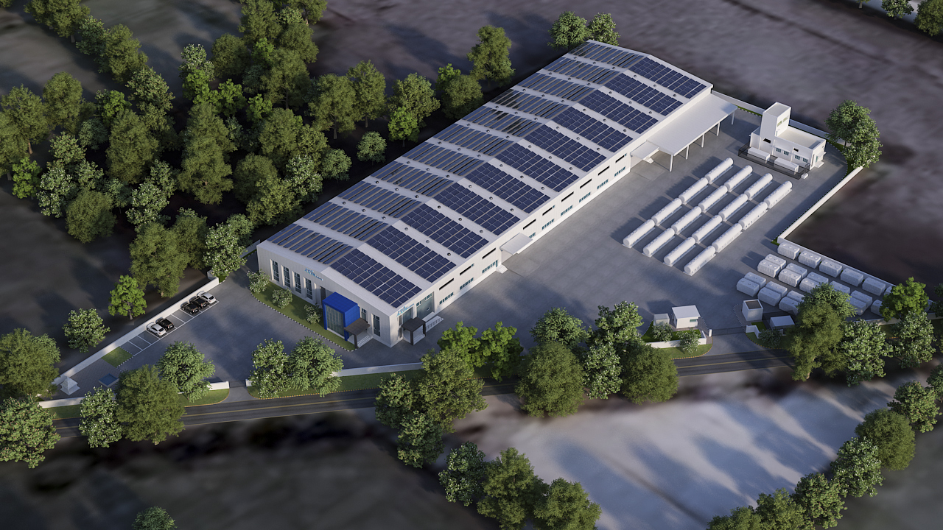
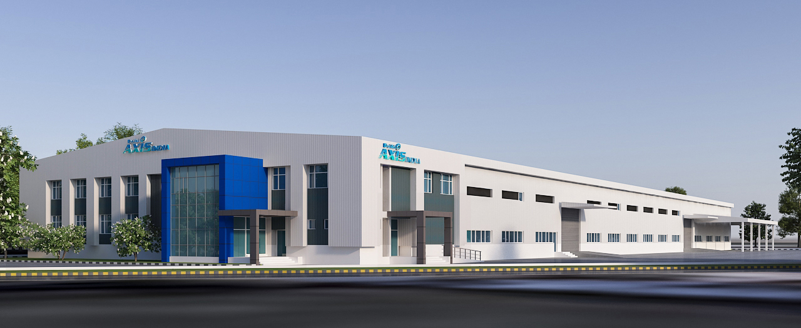
Daiki Axis Johkasou Factory, Palwal, Haryana

Slide 10
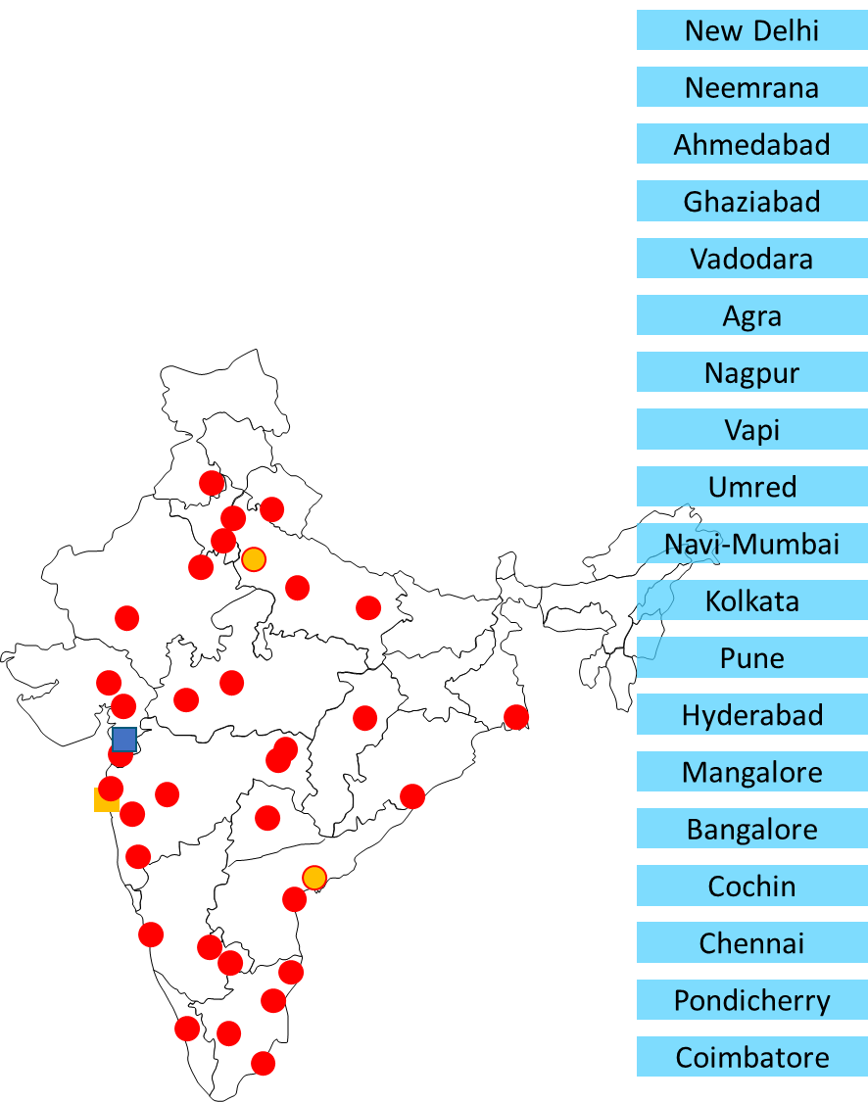
Progress made by Daiki Axis In India on Decentralized Wastewater Management..
Daiki Axis India focuses purely on Johkasou business with Two 100% Local subsidiary companies working under MAKE IN INDIA
Daiki Axis India is at the forefront in promoting of Decentralized Wastewater Management concept – Treat at Site , Reuse at Site - Extensive Offline, online and personal promotion to key stakeholders
Close working with IIT, BIS, FICCI, CII, IPA , SVSU and industries for development of market
Over 700 projects in India covering
  Residential- Individual houses, villas, farm houses, communities, slum area
  Schools& colleges, Hospitals
  Offices, IT Parks
  Hotels, restaurants, resorts
  Public Parks, Drains dropping to river
Customer coverage
  Government, Industries, Commercial, Builders
Geographical Coverage
  J&K, Himanchal, UK, UP, Punjab, Haryana, Delhi, Rajasthan, MP, Gujarat, Maharashtra, Goa, Karnataka,
  Andhra, Telangana, Tamil Nadu, Kerala, West Bengal, Odisha, Jharkhand
26 Local partner companies supporting sales, construction and maintenance
2 Factories, 100+ employees and growing ..

Slide 11
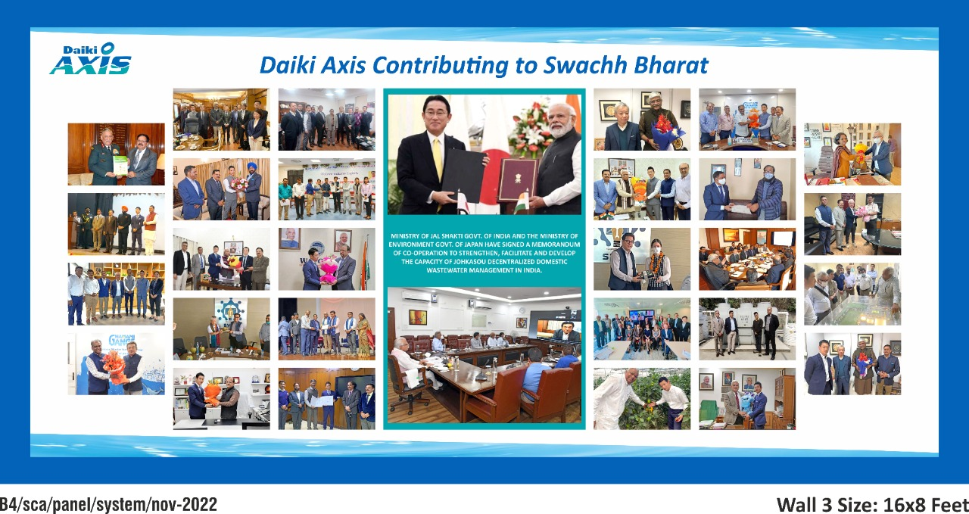

Slide 12
Foot Print and Power Requirements for different Models
 |  |  | Tank 1 [m] |  |  | Tank 2 [m] |  |  | Electric Consumption
Inflow Capacity |  | AI | W | L | H | W | L | H | [kWh] | [hp]
1 | m³/day | AI-1/C | 1.06 | 1.89 | 1.63 |  |  |  | 0.041 | 0.05
2 | m³/day | AI-2/C | 1.06 | 1.89 | 1.63 |  |  |  | 0.041 | 0.05
5 | m³/day | AI-5/C | 1.06 | 3.48 | 1.63 |  |  |  | 0.082 | 0.11
10 | m³/day | AI-10/C | 2.2 | 3.6 | 1.98 |  |  |  | 0.2 | 0.27
15 | m³/day | AI-15/C | 2.2 | 4.85 | 2.28 |  |  |  | 0.163 | 0.22
20 | m³/day | AI-20/C | 2.4 | 5.26 | 2.48 |  |  |  | 0.4 | 0.53
25 | m³/day | AI-25/C | 2.4 | 5.26 | 2.48 |  |  |  | 0.4 | 0.53
30 | m³/day | AI-30/C2 | 2.2 | 4.85 | 2.28 | 2.2 | 4.85 | 2.28 | 0.6 | 0.8
35 | m³/day | AI-35/C2 | 2.2 | 4.85 | 2.28 | 2.2 | 4.85 | 2.28 | 0.6 | 0.8
40 | m³/day | AI-40/C2 | 2.4 | 5.26 | 2.48 | 2.4 | 5.26 | 2.48 | 0.8 | 1.07
45 | m³/day | AI-45/C2 | 2.4 | 5.26 | 2.48 | 2.4 | 5.26 | 2.48 | 0.8 | 1.07
50 | m³/day | AI-50/C2 | 2.4 | 5.26 | 2.48 | 2.4 | 5.26 | 2.48 | 0.8 | 1.07
Cost of 1 KLD(One to 2 family system:
Product Price - INR 1,60,000/-
Capex estimate - INR 1,95,000/-
Operation cost per year - INR 7,624/-
Outcomes
Complete Grey& Black water onsite treatment, Reuse of treated used water
No need for common FSTP, Grey Water Treatment projects
Expected working Life – 30 Years
**Space can be utilised as car parking or green cover in case of under ground installations.

Slide 13
Few Case Studies
from India for Grey & Black Water treatment, FSTPs

Slide 14
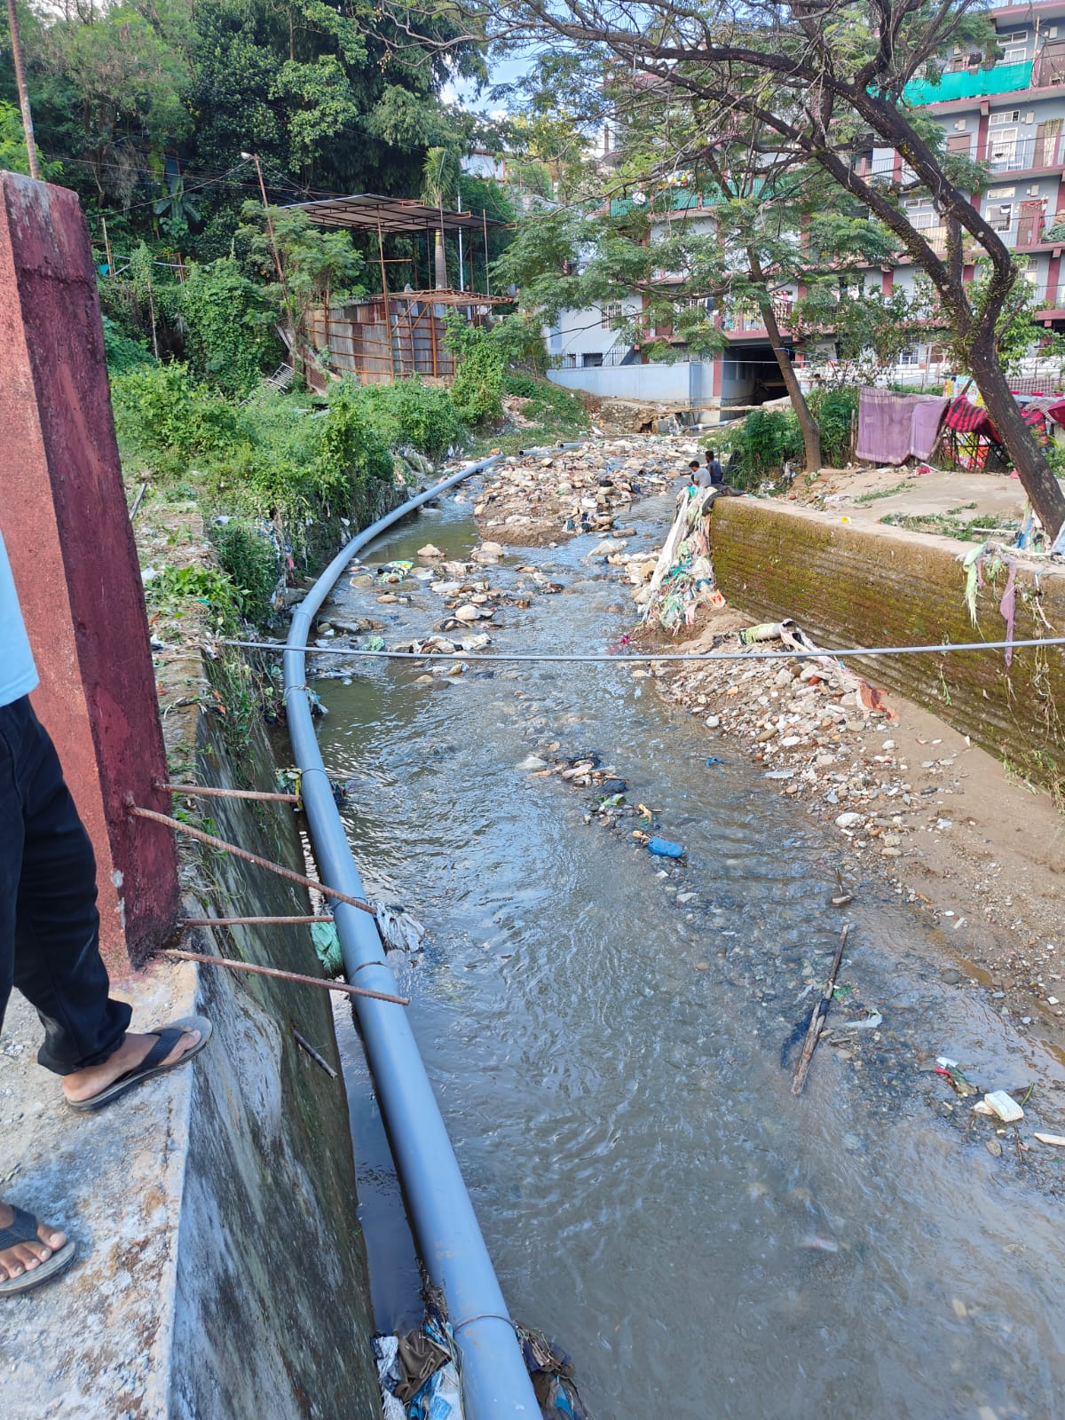
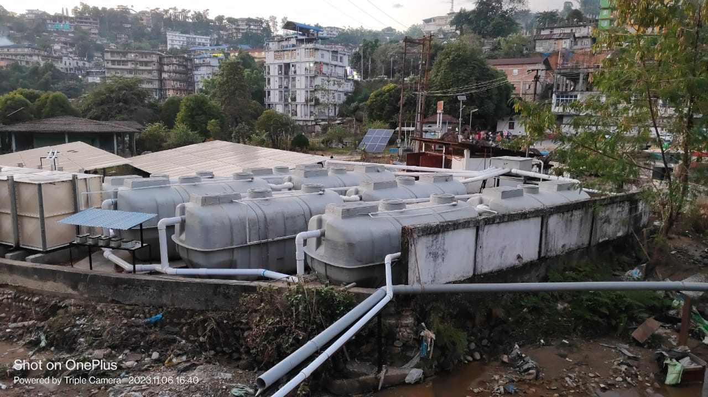
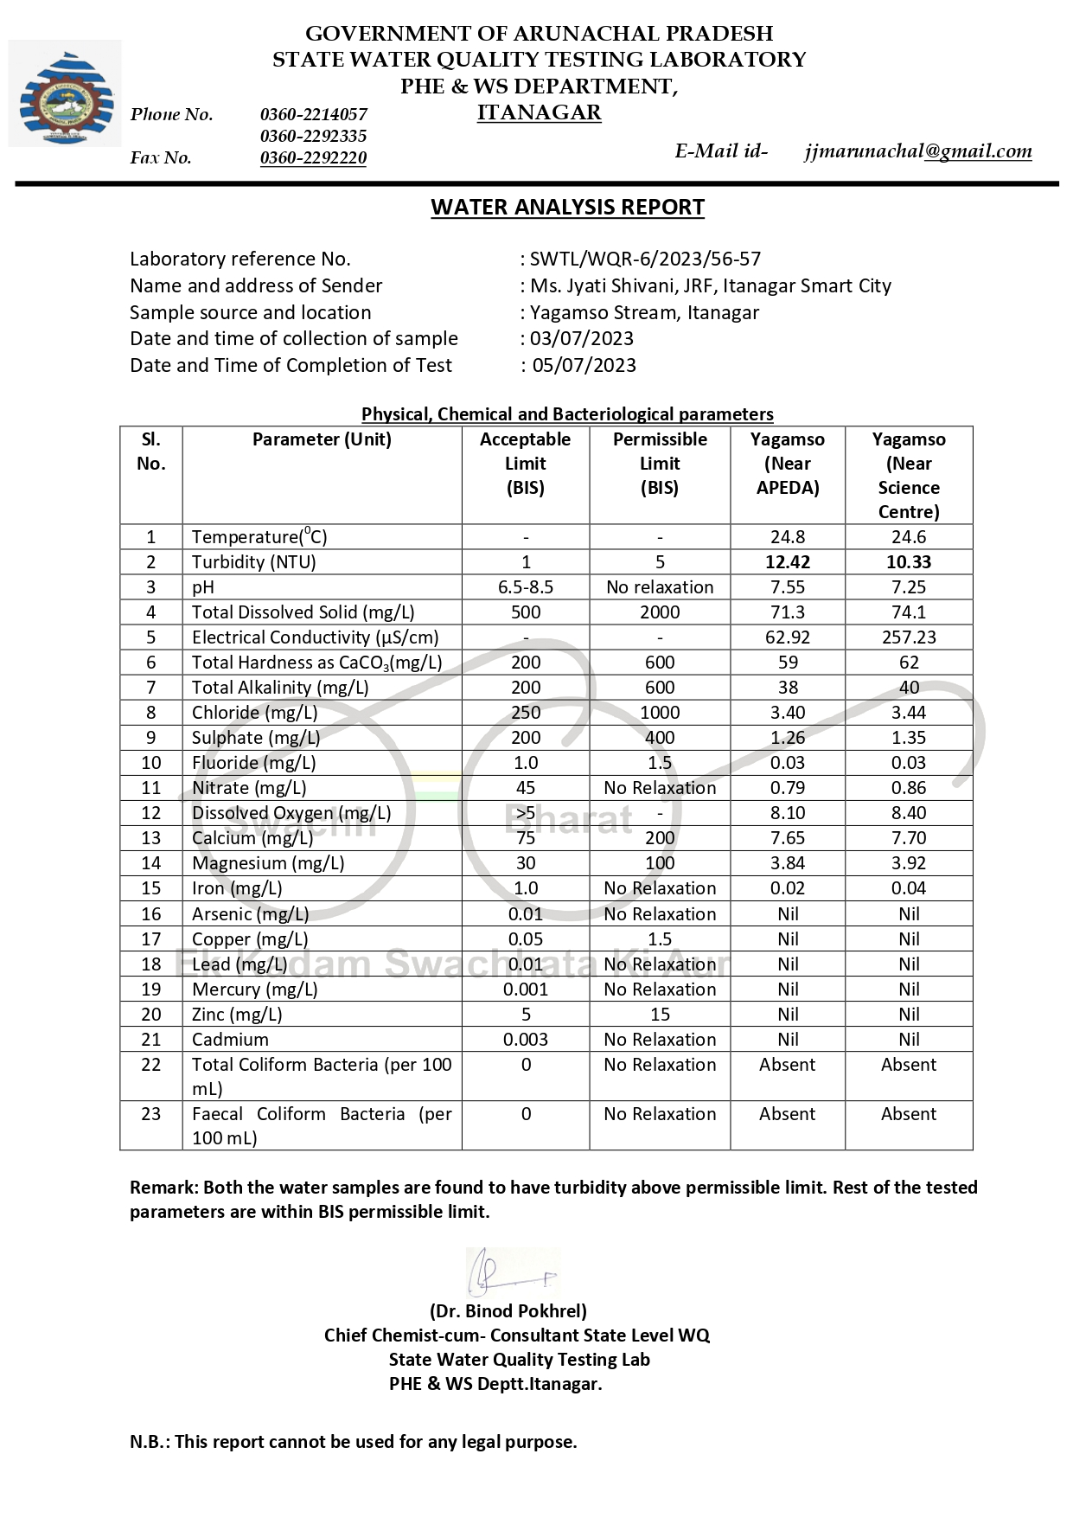
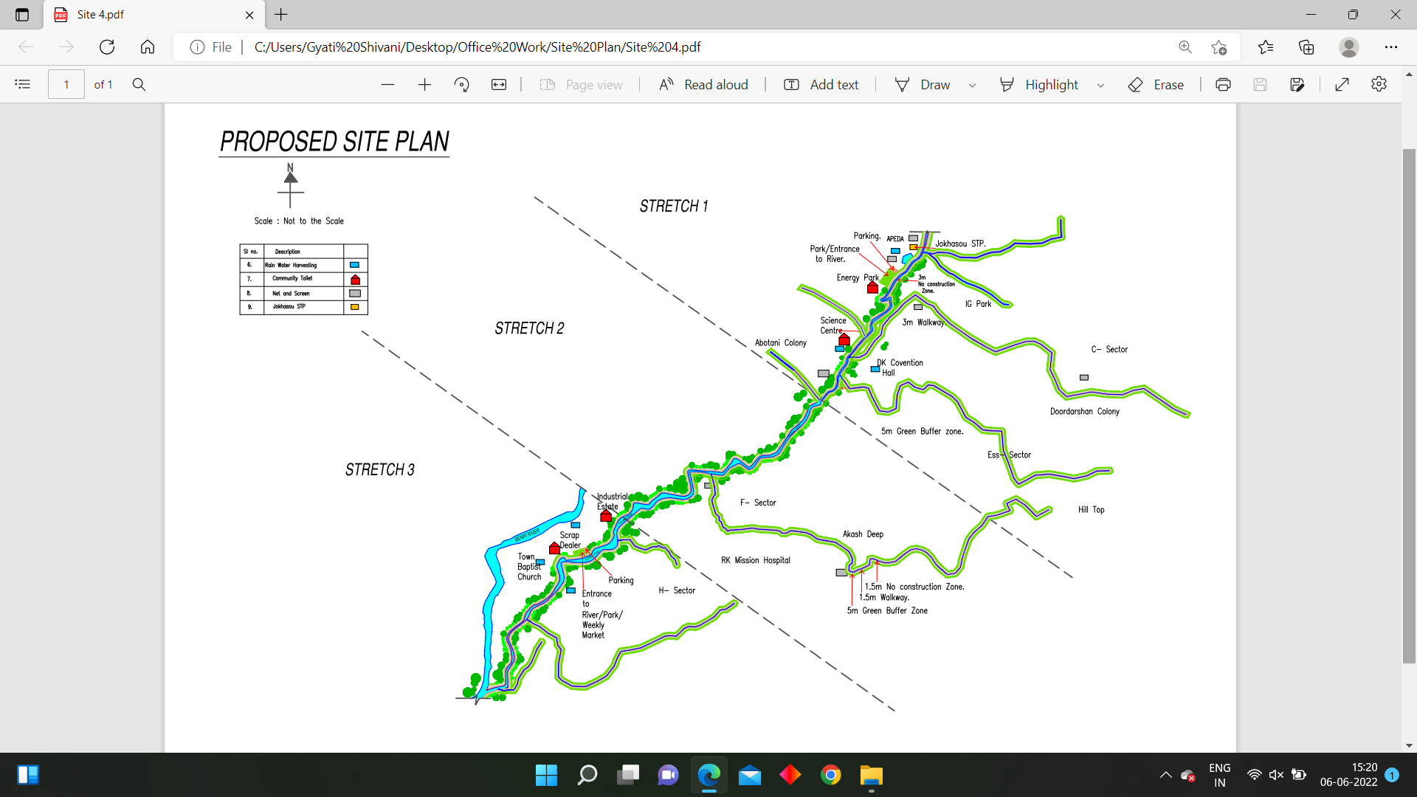
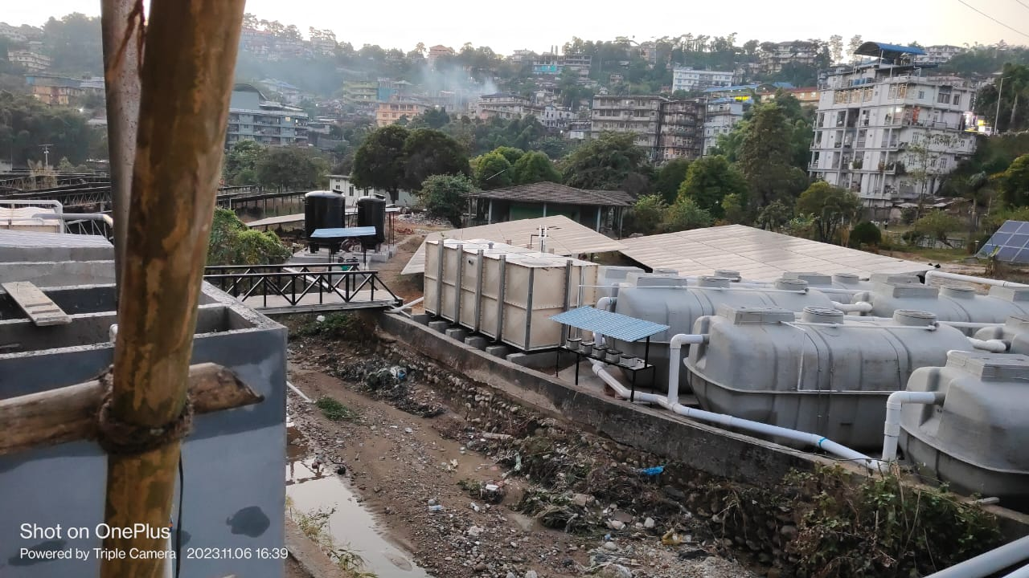
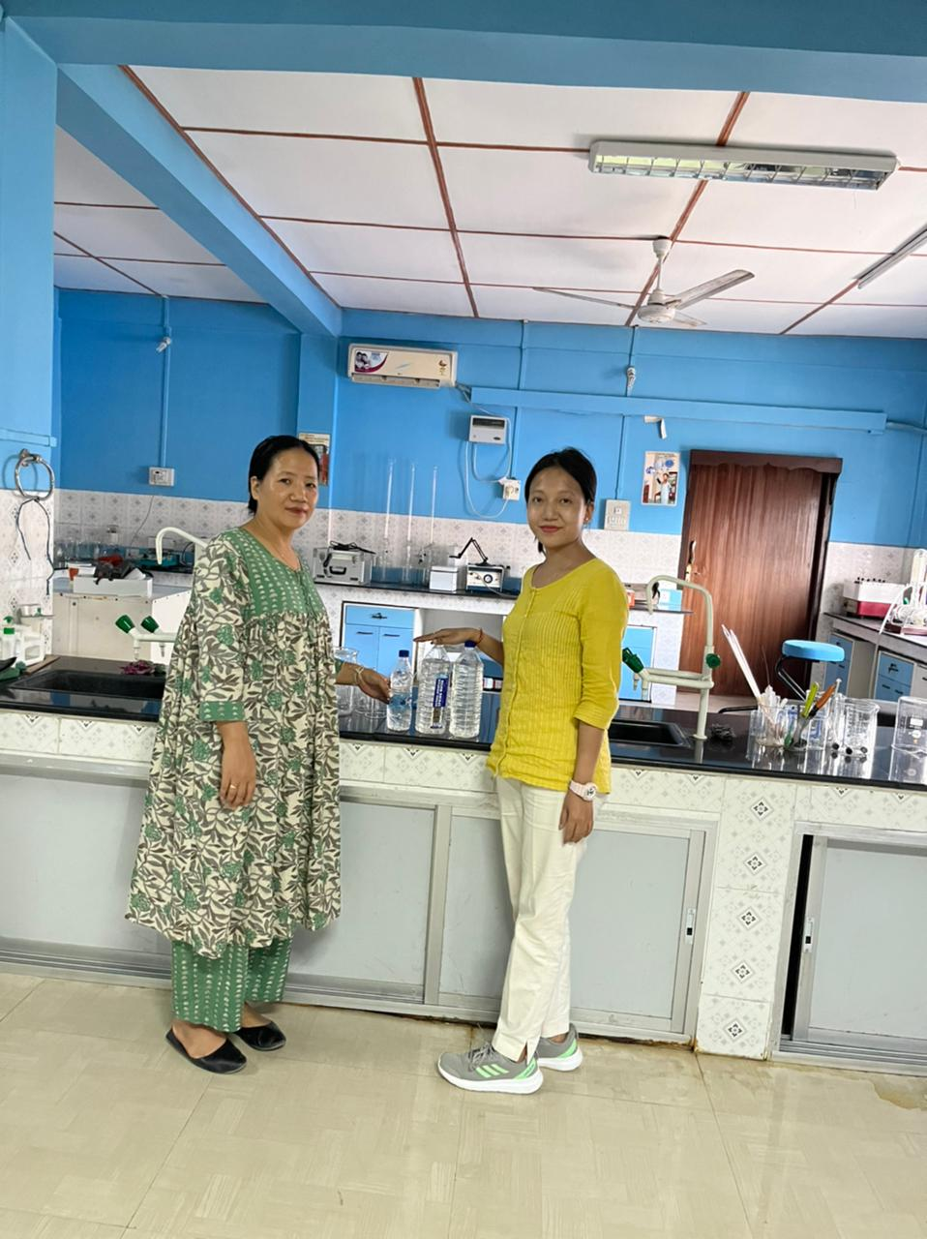
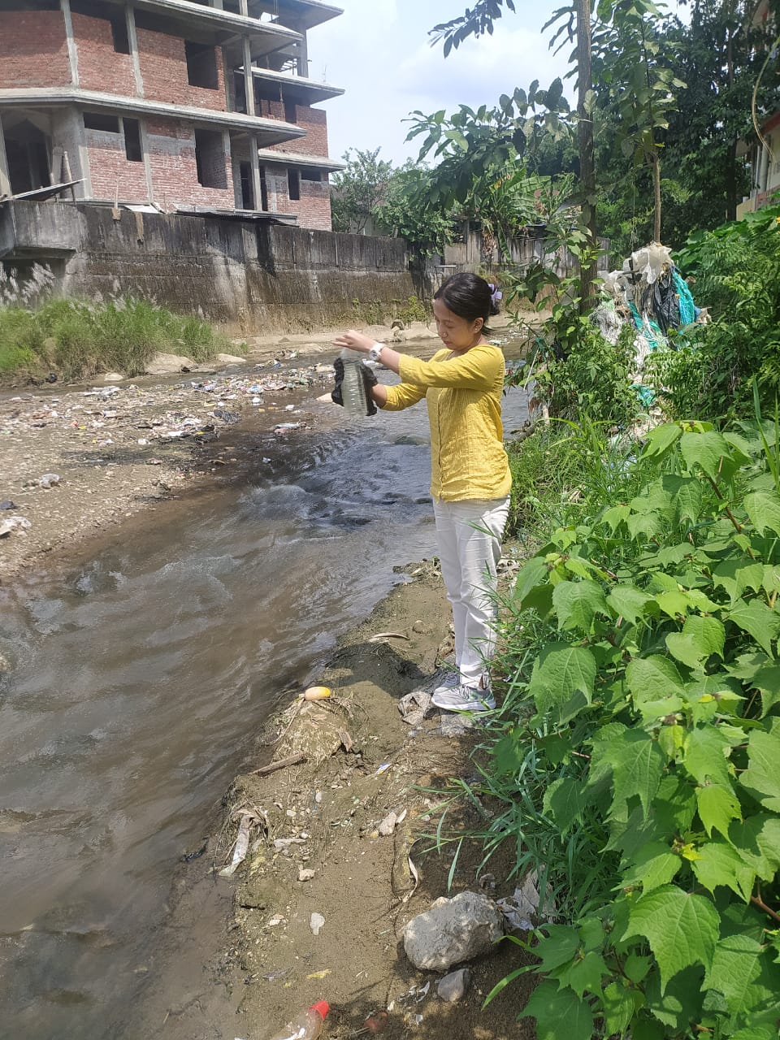
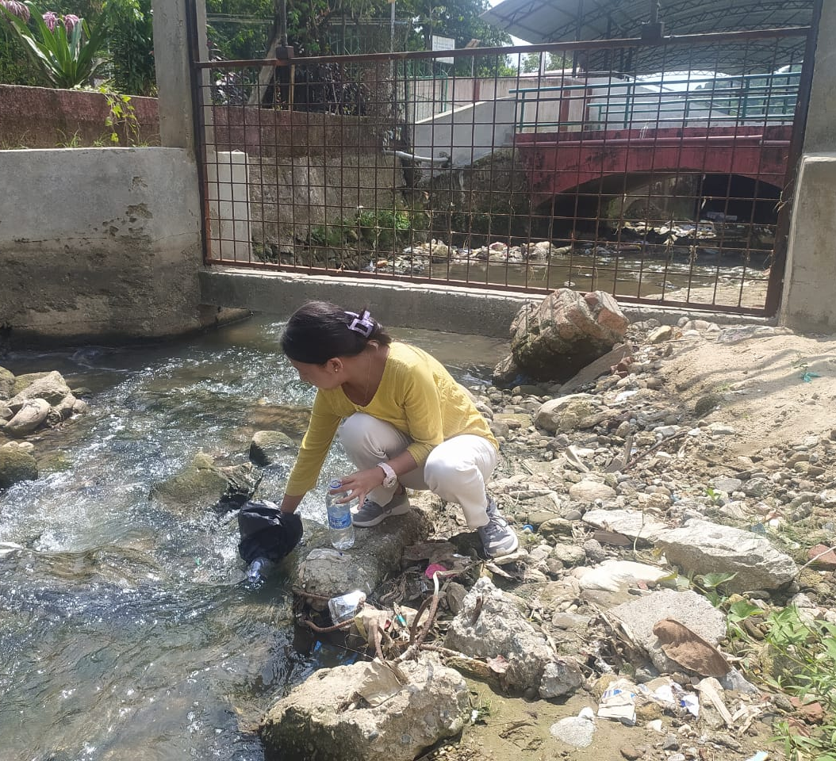
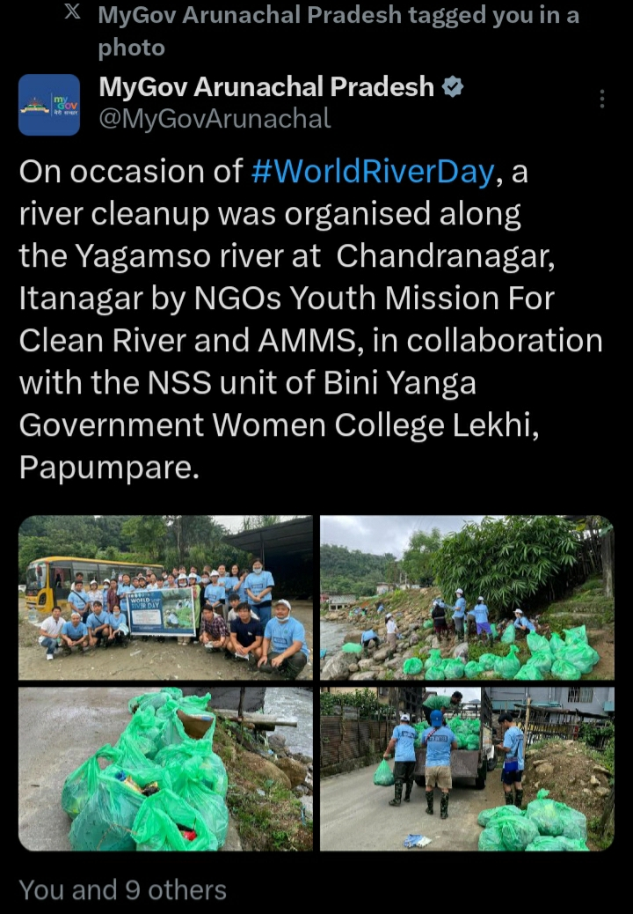
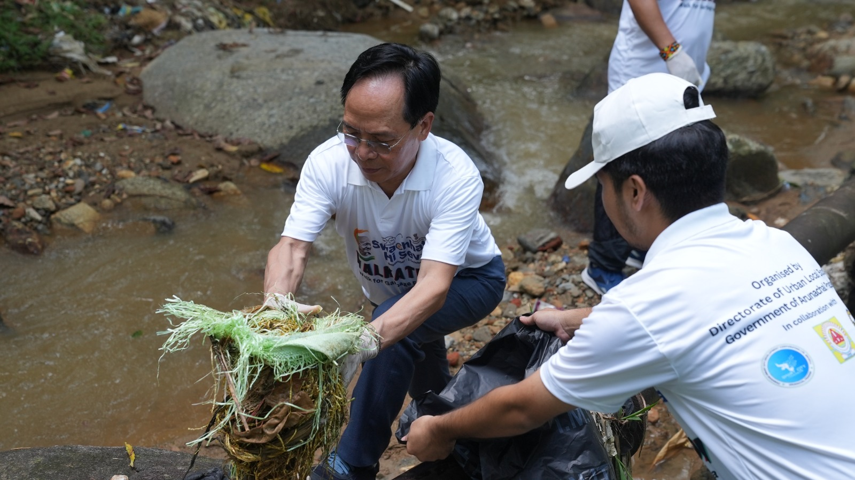
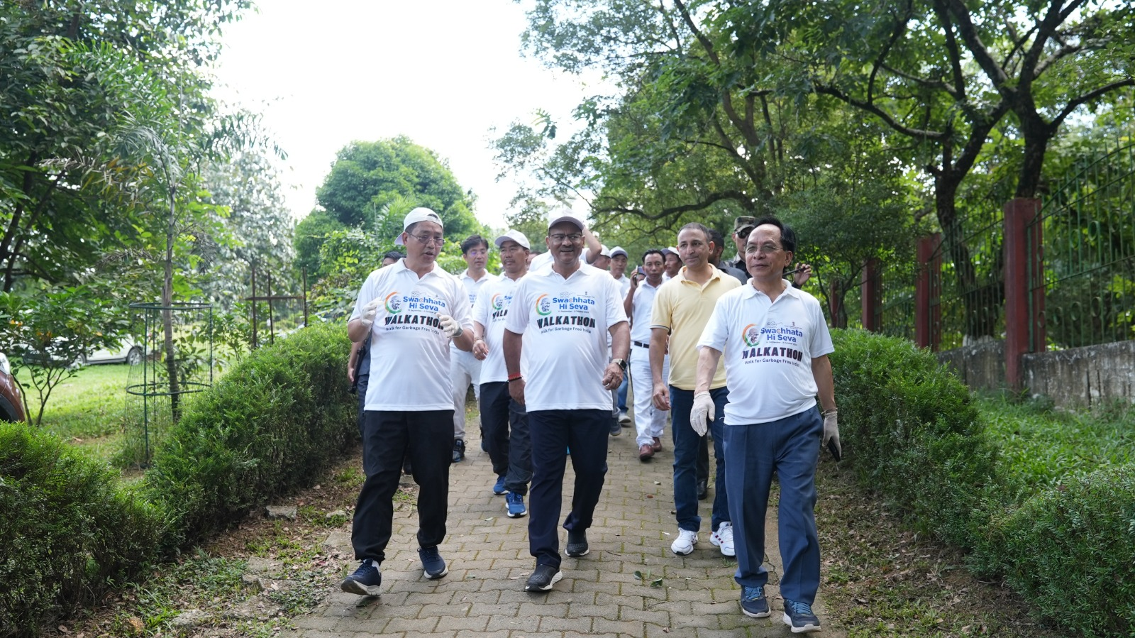
Yagamso River, Smart City Itanagar Project
Map showing the location of Johkasou STP
PROJECT REPORT
Itanagar Smart City Development Corp. Ltd

Slide 15
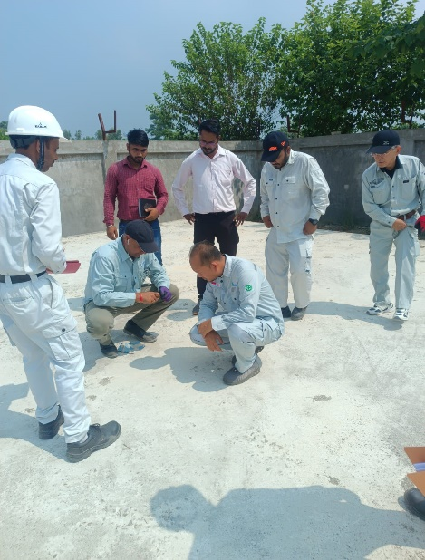
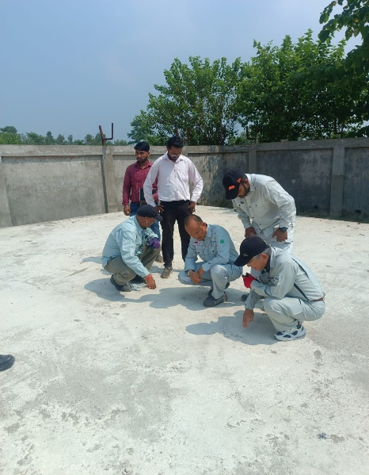
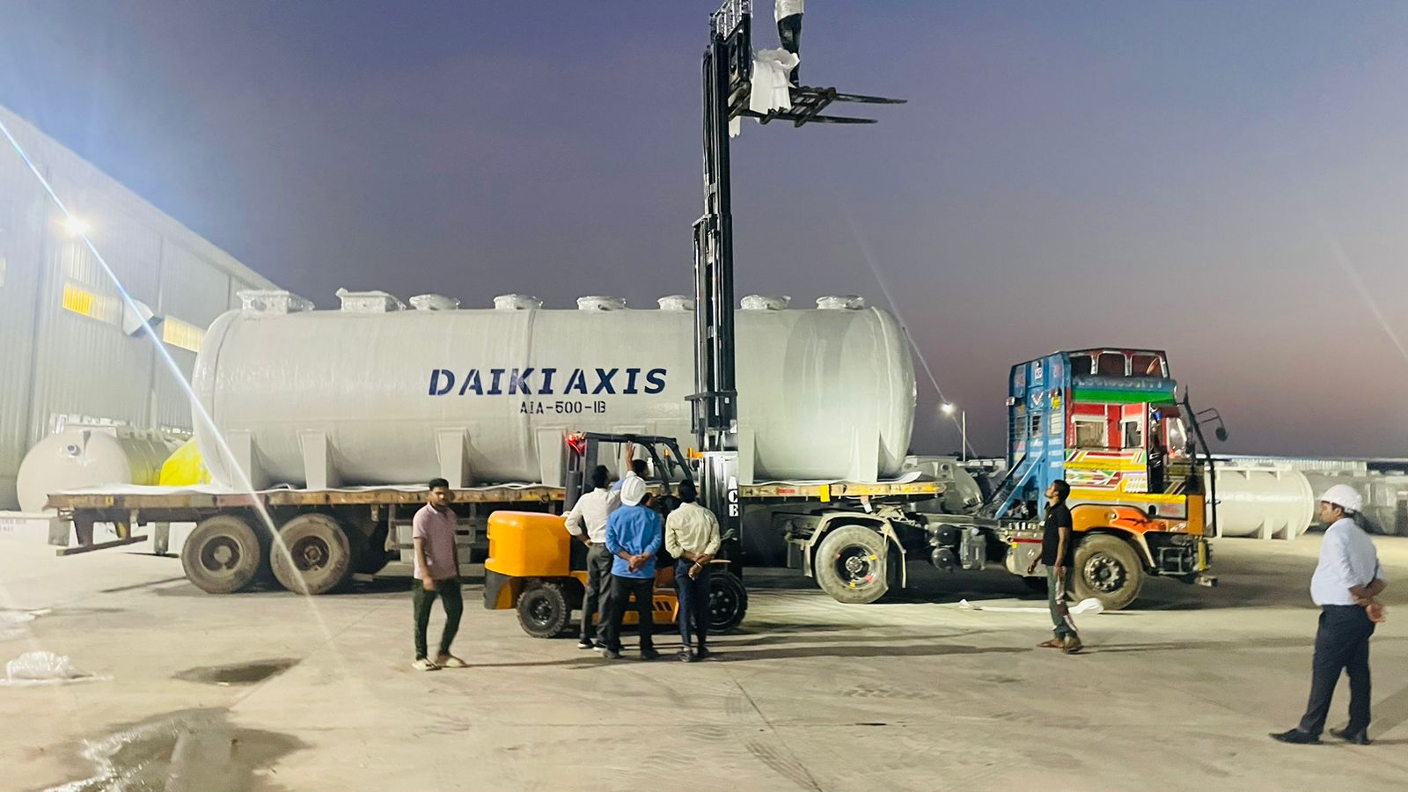
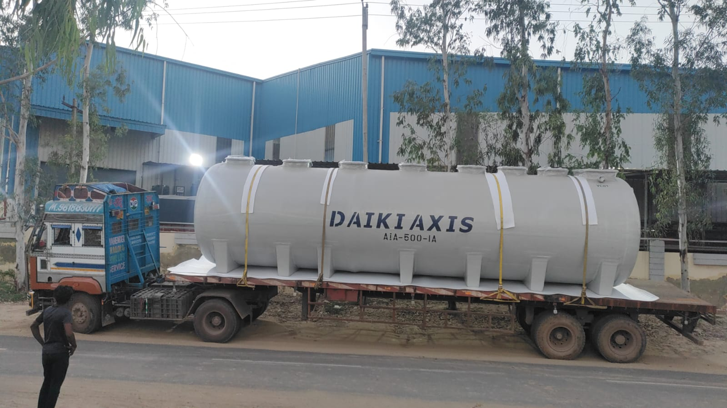
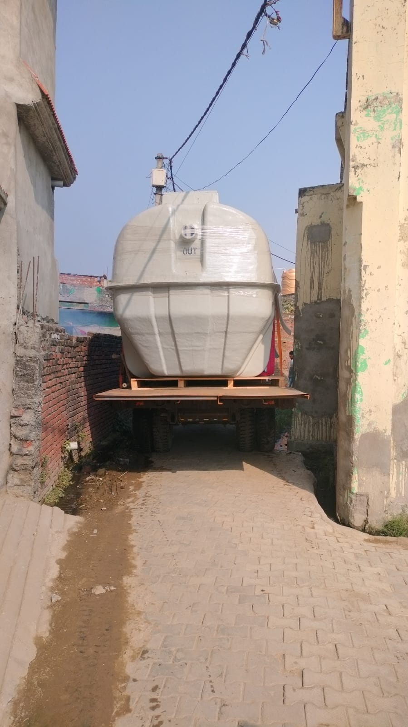
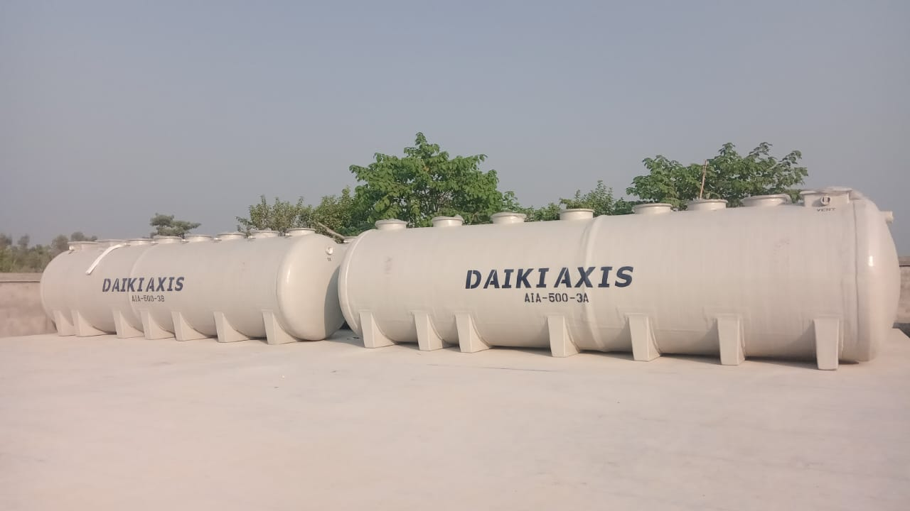
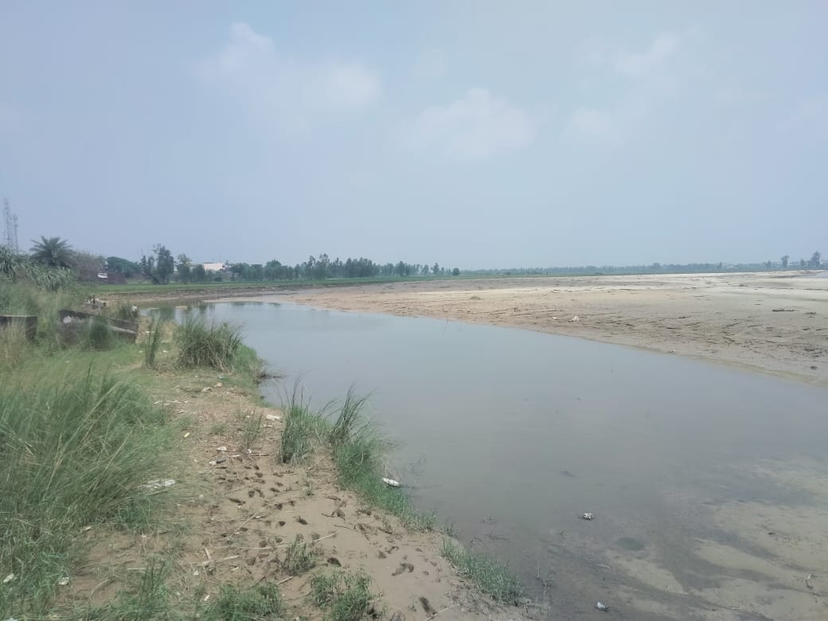
NMCG UDHAM SINGH NAGAR 1300(500,300,500) KLD VILLAGE SANITATION RIVER CLEANING PROJECTS , UTTARAKHAND
Notes:
Japanese water treatment history was history of sustainability of the development

Slide 16
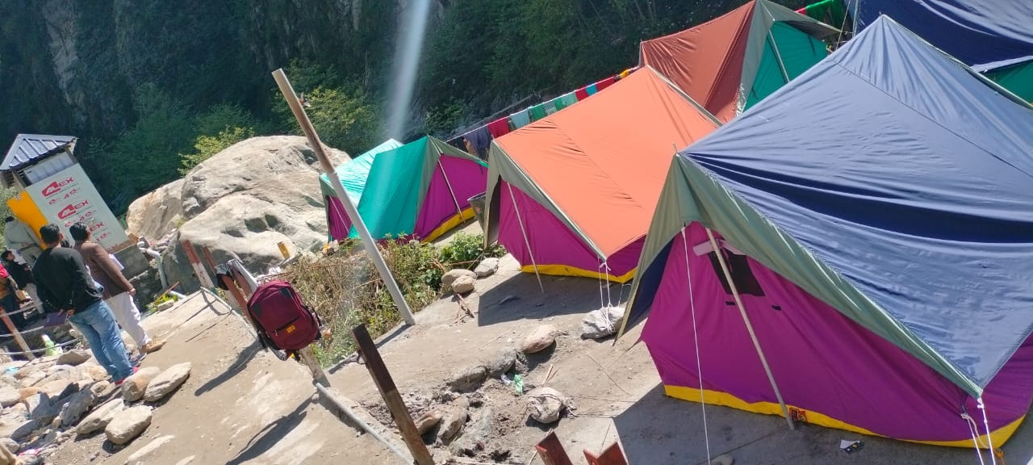
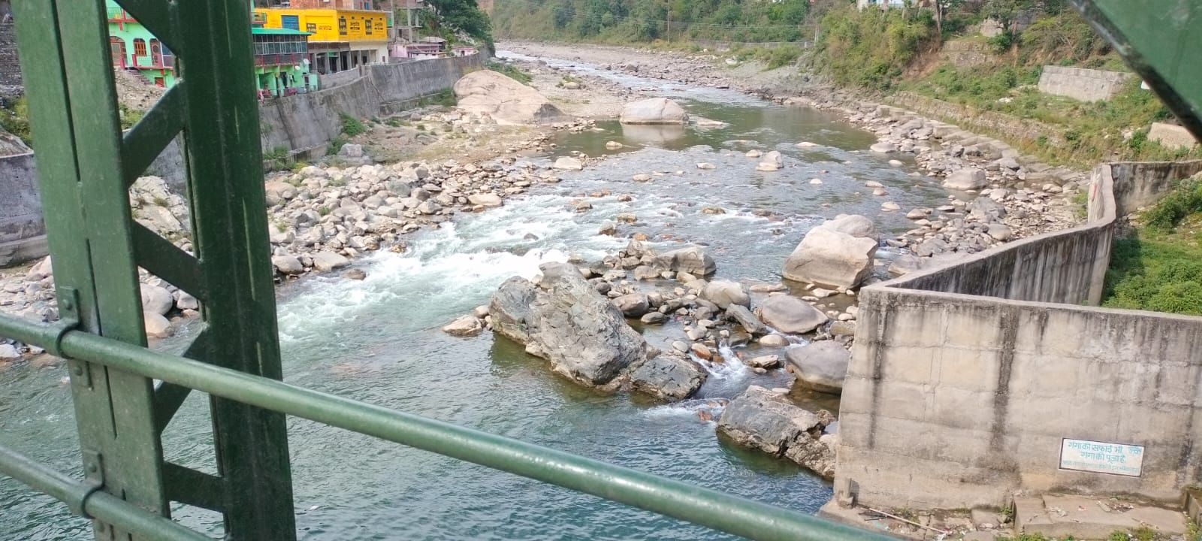
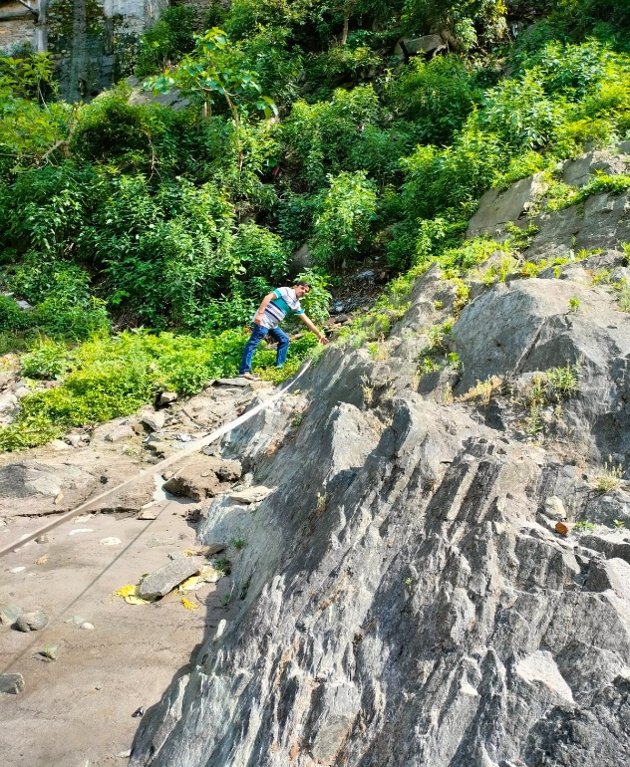
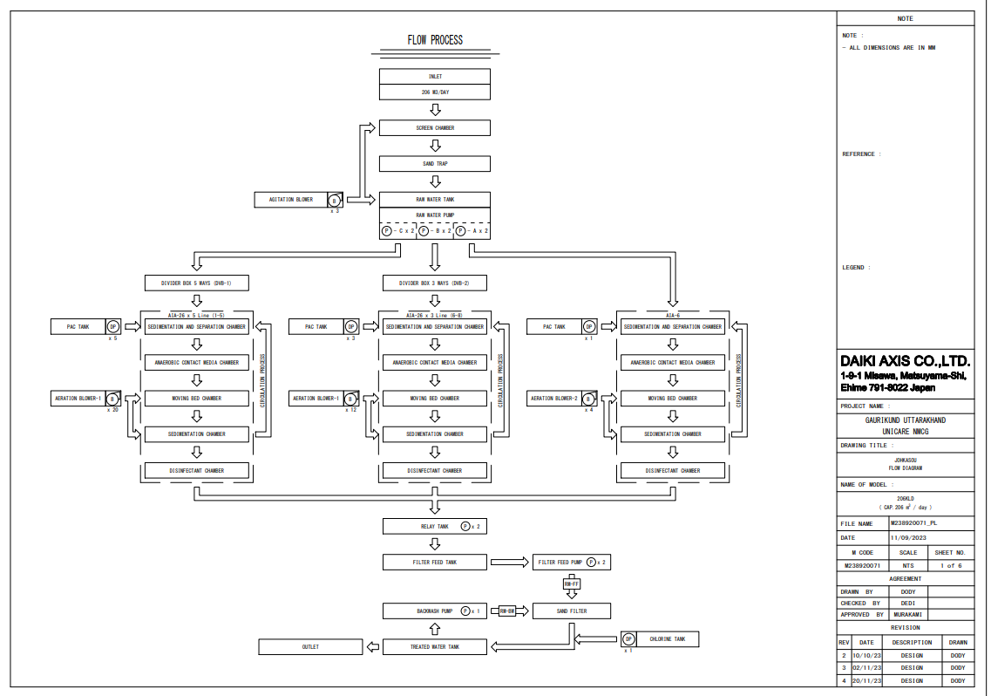
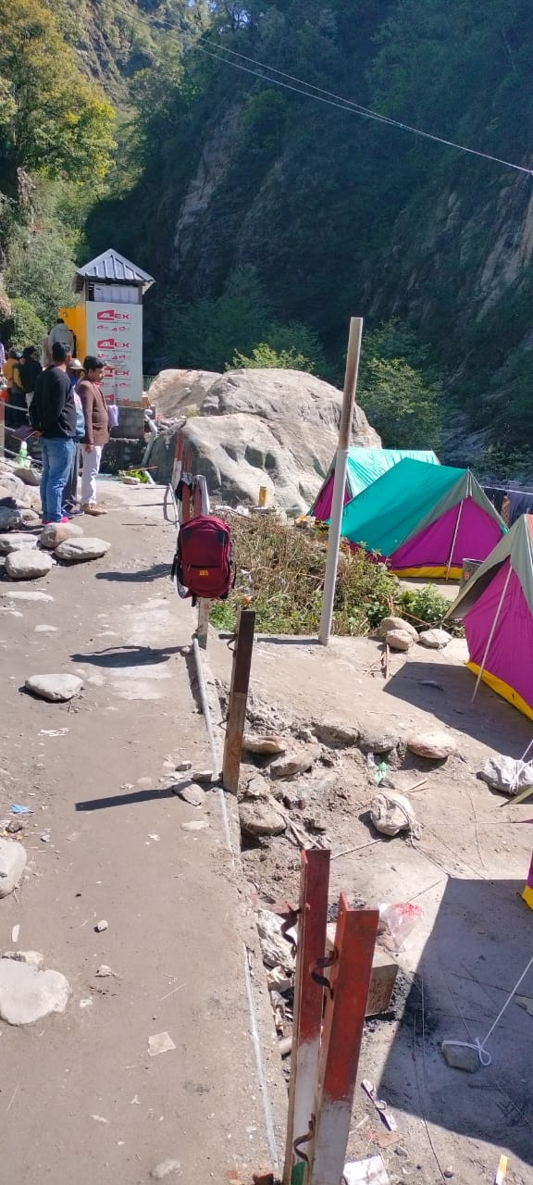
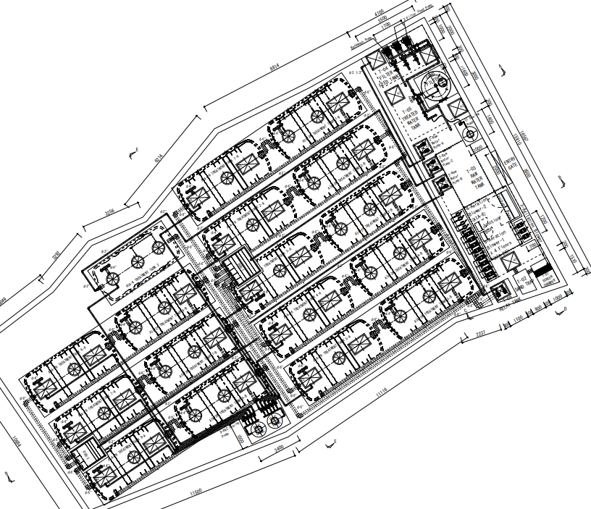
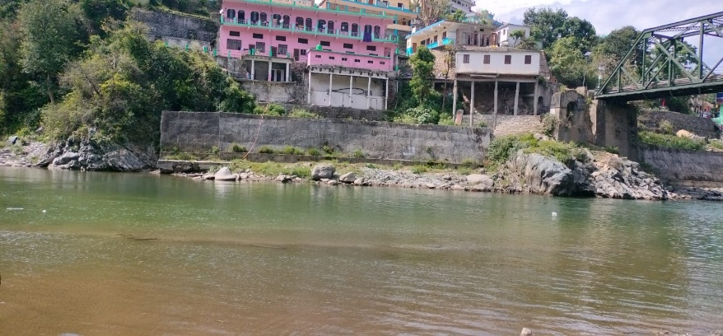
Gauri Kund, Uttarakhand

Slide 17
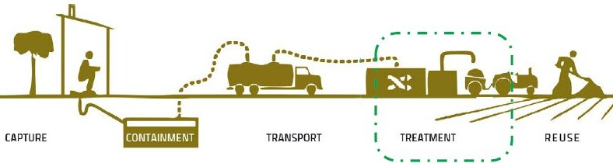
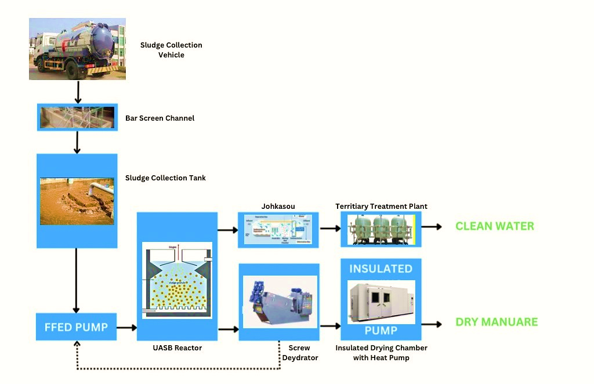





Namsai, Arunchal Pradesh FSTP (Collection ~ Product Usage)

Slide 18




Flow Diagram of NAMSAI FSTP
Fertilizer process
Sludge Cake
Sludge
Screen
SF & AC
Storage Tank
Coagulation
tank
Treated
water tank 1
Back wash
Polymer tank
Treated
water tank 2

Slide 19
Top Fit Cases for Johkasou
1. Urban villages
2. Water stress villages
3. Villages on river banks
4. NGT Priority villages
5. Villages with Typical topography

Slide 20





Daiki Axis India has established model for Decentralized Used water solution
De-centralized used water management in India is still under nascent stage hence DAI is working on multiple fronts to support the customers and improve the industry skill and quality level in India
Simultaneously work on Development of Indian Market for Awareness creation, product enhancement, cost reduction, standard formation,
skill development
1. FIELD SURVEY, REQUIREMENT STUDY, DPR SUPPORT
2. TWO STAGE ENGINEERING SUPPORT FOR THE PROJECT
3. MANUFACTURING - MAKE IN INDIA AS PER JOHKASOU STANDARD & INDIAN REQUIREMENTS
4.CONSTRUCION QUALITY AND SUPERVISION AS PER DAIKI STANDARD
5. O&M , USER TRAINING AND ASSET MANAGEMENT SUPPORT AS PER DAIKI STD.

Slide 21


Thank you!
Daiki Axis Environment/Daiki Axis India Pvt. Ltd.
Kamal Tiwari,
CEO & Director
Tel: +91-9810367527 (WhatsApp)
Email: kamal@daiki-axis.com
Scan to download PPT & Video

